Slide 1

Post-Con Workshop – HTML5 Smart Client with AngularJS and Razor
Aidan Ryan
Solutions Architect
@ajryan
Level: Intermediate

Slide 2
What We Can Cover
Angular+TypeScript project Skeleton
Building an AngularJS app with TypeScript
Responsive Web Design
Charting with NVD3
Real-Time Messaging with SignalR
Unit Testing JavaScript Applications
UX Review
Web API Security with Azure Mobile Services Social Sign-In
VS Application Insights
Notes:
From a green field, we’ll build a simple SPA that consumes a simple WebAPI service
Starting with an ASP.NET MVC SPA-oriented skeleton project
We’ll pull in AngularJS and build up controllers, services, and directives
We’ll show use of Azure Mobile Services social login
We’ll apply Responsive Web Design to make the site useable from mobile devices

Slide 3
ASP.NET MVC SPA Skeleton
VS2012 Base Template
Too much out of box
NuGet woes
VS2013 Template a-la-carte
Best to start stripped down
Empty ASP.NET application, pull in NuGet packages
My template on GitHub
http://github.com/ajryan/NgTypeScript
Notes:
The VS2012 base MVC4 template has too much in it out of the box.
A NuGet upgrade from the base template can cause big issues. Primary is Package Restore on a clean tree – the BCL libs have a catch-22
The VS2013 template lets you do some a-la-carte customization, but still pulls in more than we want
It’s useful to have a base skeleton template where you can add NuGet packages on demand.
Pull down my template from GitHub as a starting point.

Slide 4
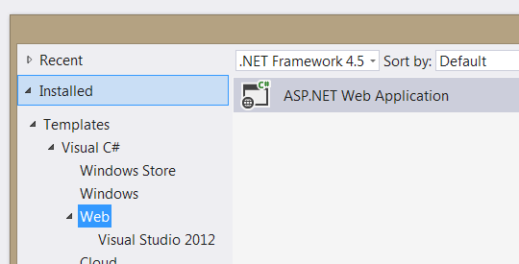
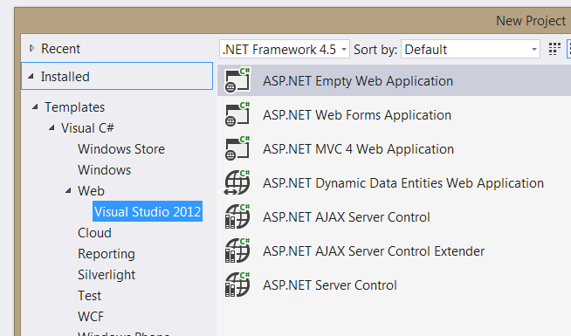

Slide 5
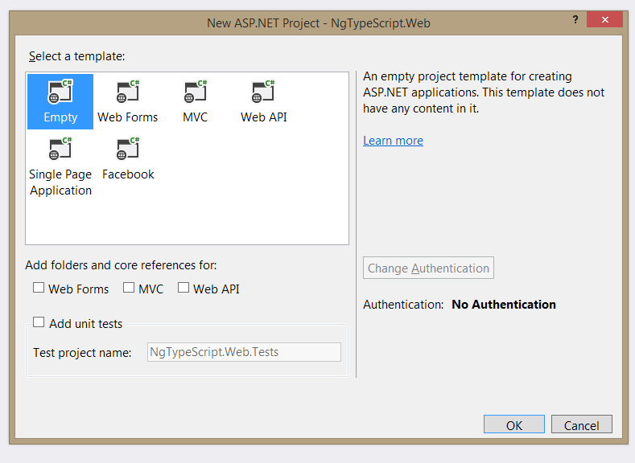

Slide 6
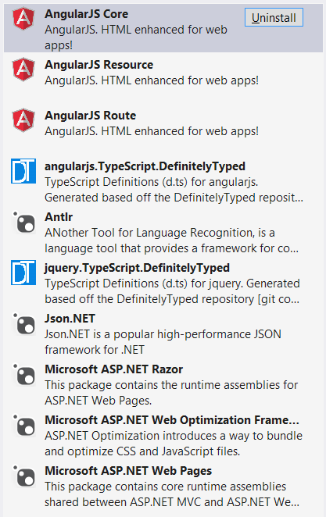
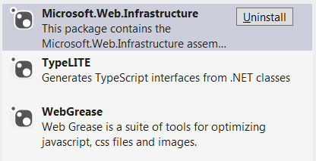
Update to Stable
Add:
Angular core, route, resource
TypeScript definitions for Angular and jQuery
ASP.NET Web Pages
TypeLITE

Slide 7
AngularJS
Complete client-side framework
Data binding
Dependency Injection
Routing
Services
Directives
REST Client
Promises
TypeScript!
Unit Testing
Notes:
AngularJS is a complete client-side framework. Compare to other JavaScript libraries – Knockout is purely databinding-oriented. Backbone is a set of libraries that you compose together in your own framework. AngularJS is opinionated about component roles and lays out a well-defined structure for you to build your app within.
We’ll look at the following AngularJS capabilities: Data binding, Dependency Injection, Routing, Services, Directives, the REST Client, and Promises
Working with AngualrJS (or any JavaScript library, for that matter) is more productive and less error-prone when you use TypeScript.
We’ll look at unit testing AngularJS components.

Slide 8
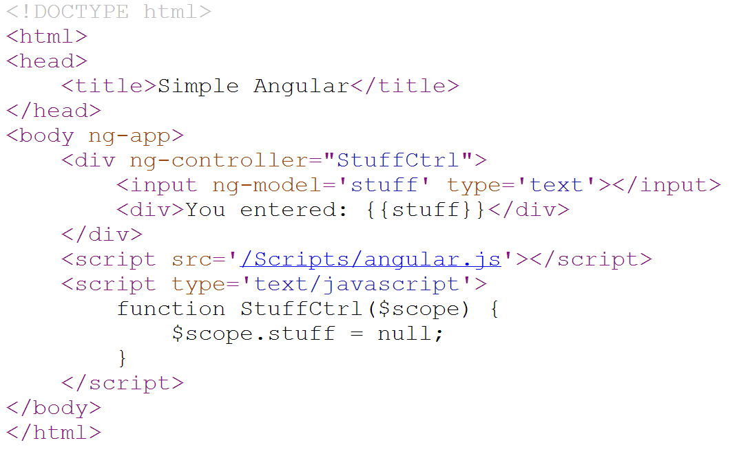

Slide 9
TypeScript with AngularJS
Module = app
Class = controller, service, etc
Strong-type your model ($scope) with TypeLite
Notes:
Using TypeScript with AngularJS brings type safety and error checking to the compile stage. The TypeScript compiler enforces correctness before you run, saving tons of time. VS IntelliSense is really nice here too.
You can use TypeLite to code-gen TypeScript classes for your models. I love static typing, it keeps me sane. The farther I can project it into the client side, the better.

Slide 10
From Zero
Global.asax.cs
Bundling and Minification
Web API Route Registration
Default.cshtml
Config values, declare the Angular module
Define a Model class and generate TypeScript def with TypeLITE
Add a Web API controller
Build your first Angular controller

Slide 11
AngularJS Data Binding
Controller / Scope
In the markup
{Templating}
ng-model
ng-bind
ng-repeat
Notes:
[DEMO]

Slide 12
AngularJS Routing
URL matching
Think MVC Route table
Fallback
Notes:
[DEMO]

Slide 13
AngularJS Dependency Injection
Standard Syntax
Script File Management
Notes:
[DEMO]

Slide 14
AngularJS Services
Extract Cross-Cutting Concerns
Backend client
External services
Auth*
Notes:
[DEMO]

Slide 15
AngularJS Directives
Markup enhancements
Think
MVC HtmlHelper and Display/Editor Templates
XAML Attached Behaviors
Notes:
[DEMO]

Slide 16
AngularJS REST Client
Resource-oriented AJAX
Notes:
[DEMO]

Slide 17
AngularJS Promises
Async
Think C# async / await
Notes:
[DEMO]

Slide 18
Azure Mobile Services Social Login
NuGet the client SDK
TypeScript definitions
Notes:
[DEMO]
Social Login with Azure Mobile services is easy and useful. NuGet and TypeScript definitions get you there faster.
Think about auto-login. You can use cookies or localStorage to cache a token, but there is a security risk there.

Slide 19
Security
Azure Mobile Services JWT
Authentication: leverage ZuMo
Authorization: build your own
[DEMO]
JWT authentication
Generate Sig
Shared Secret
Token Authority (Azure Mobile Services)
Issue
Validate Sig
Client
Present
Server with Resources
Notes:
Authentication lets you claim a unique ID issued from a trusted authority (ZuMo)
ZuMo will tell you someone “is who they say they are” but it’s up to you to decide what you want them to be able to do.
[DEMO] JWT authentication
---- MediaManager / Auth / JsonWebTokenValidationHandler
Impersonation risk if JWT is intercepted or retrieved from localStorage. Can mitigate by requiring login every time, and

Slide 20
Responsive Web Design
Further elevate your code :: eyeball ratio
Foot in the door for mobile devices
Invest in your base template
Core technique: media queries
Notes:
RWD is about maximizing reach of a single codebase. You can go RWD from the start on a site and hedge your bets on native mobile. If you go big, re-evaluate native.
Think hard about your base template – desktop or mobile first? Where do you serve the most content? Break out your “bigger” and “biggest” CSS and JavaScript and don’t serve them to mobile devices.
Media queries are the core technique to investigate.

Slide 21
Responsive Techniques
Size and position for mobile
Grid frameworks
Adaptive images
Notes:
[DEMO]

Slide 22
Charts: NVD3
d3.js
Data -> DOM mapping
nvd3.js
Data -> SVG mapping == CHARTS!
[DEMO]
Angular directive, chart in markup, controller data-binding
Notes:
[DEMO] pullResult.cshtml, pollResult.ts

Slide 23
SignalR
Real-time push communication
Notifications, streaming, etc.
Azure Web Sites now supports Web Sockets!
[DEMO]
New poll notification
Notes:
Default.cshtml – line 30 – new poll message display
App.ts line 96 – listen for poll added, set new poll count
Signalr.ts – public addPoll, pollAdded listener
OwinStartup.cs – bootstrap to map signalr route
MyVoteHub.cs – send message to all but sender (Clients.Others)

Slide 24
Unit Testing
Jasmine Framework
Mocking
Asserts
Angular Mocks
Runners
Chutzpah (“HUTZpah”)
Karma
Jasmine host page
ReSharper
Coverage
[DEMO]
Notes:
Chutzpah from console w/ coverage

Slide 25
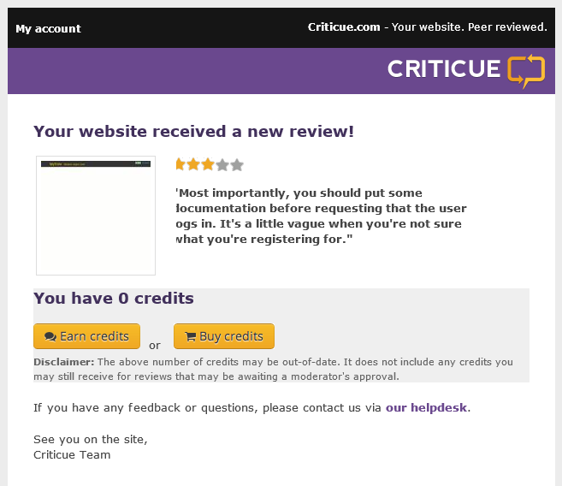
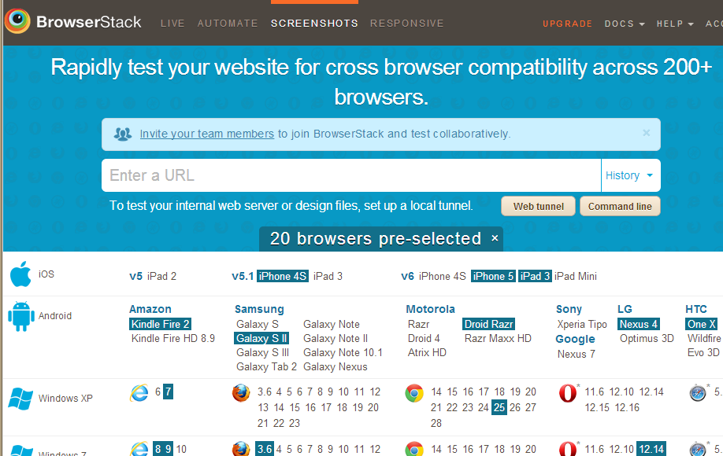
UX Review

Slide 26
Performance
Areas to watch:
Bandwidth
Request count
DOM complexity
JavaScript performance
Techniques
Caching
Bundling / minification
Avoid round trips
RequestAnimationFrame
Tools
New Relic
VS Online Application Insights
Notes:
There are four primary dimensions to SPA performance – bandwidth, request count, DOM complexity, and JavaScript performance.
Bundling & minification, caching, and image spriting let you deal with the network layer issues.
DOM complexity is a design-time issue. Think early and often about trimming the fat in your layouts.
JavaScript performance:
- Cache selectors
- Use $on instead of $click etc. Put your selectors on top-level objects with a selector
- Requestanimationframe

Slide 27
[DEMO]: Bundling/Minification, Monitoring, Monaco
Notes:
Bundle / Min in Global.asax.cs; tweak web.config and show debug vs. release
Application Insights – NOT fully baked, definitely early stages
- Localhost in reporting
Monaco – make a tweak and see it live (start from azure mgmt. portal)

Slide 28
Useful Links
Azure Mobile Services Docs
http://www.windowsazure.com/en-us/develop/mobile/
AngularJS Docs
http://docs.angularjs.org/api
AngularJS Guides
http://egghead.io/
http://thinkster.io/

Slide 29
Questions?

Slide 30
Aidan Ryan
AidanR@magenic.com
@ajryan
http://www.aidanjryan.com
https://github.com/ajryan

